Slide 1


Artificial Intelligence 4 Anti Corruption
The Prevention and Combating of Corruption Bureau, in collaboration with the University of Dar es Salaam
Dr Michael S. Mollel (PhD)

Slide 2
Introduction

Slide 3
Objectives
Objective: Enhance transparency and accountability in Tanzania’s public procurement and project monitoring using advanced AI and machine learning techniques.
System Capability:
Text Generation: Assist investigators by generating relevant text using generative AI.
Text Classification: Classify documents such as corruption/no corruption.
Anomaly Detection: Identify irregularities and anomalies in procurement data.
Multimodal Analysis: Integrate various data types for comprehensive insights.
Demo: https://cd82-41-78-64-251.ngrok-free.app/

Slide 4
Dataset Status
Region | Status | Region | Status
Arusha | 50 | Morogoro | 0
Dodoma | 45 | Mtwara | 40
Geita | 50 | Mwanza | 0
Ilala | 0 | Njombe | 0
Iringa | 50 | Pwani | 0
Kagera | 11 | Rukwa | 40
Katavi | 0 | Ruvuma | 25
Kigoma | 27 | Shinyanga | 26
Kilimanjaro | 0 | Simiyu | 50
Kinondoni | 0 | Singida | 50
Lindi | 50 | Songwe | 50
Manyara | 38 | Tabora | 44
Mara | 0 | Tanga | 38
Mbeya | 50 | Temeke | 0

Slide 5
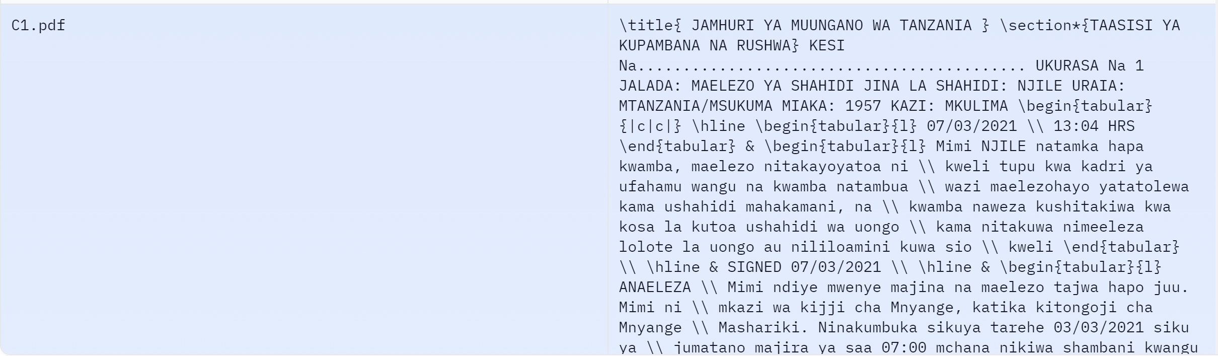
Pre-training Dataset

Slide 6
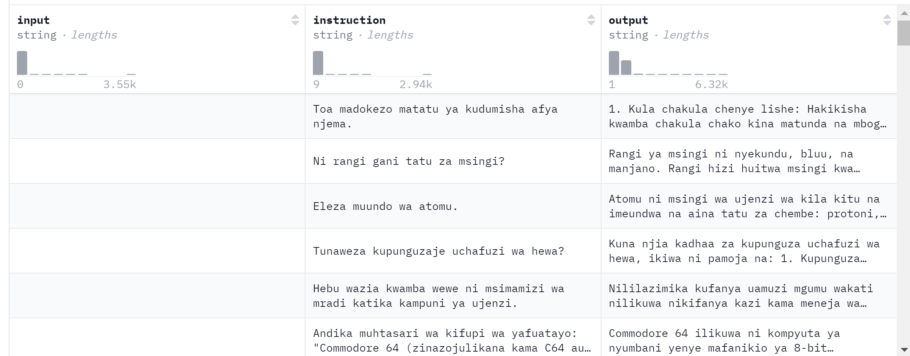
FineTune Dataset

Slide 7
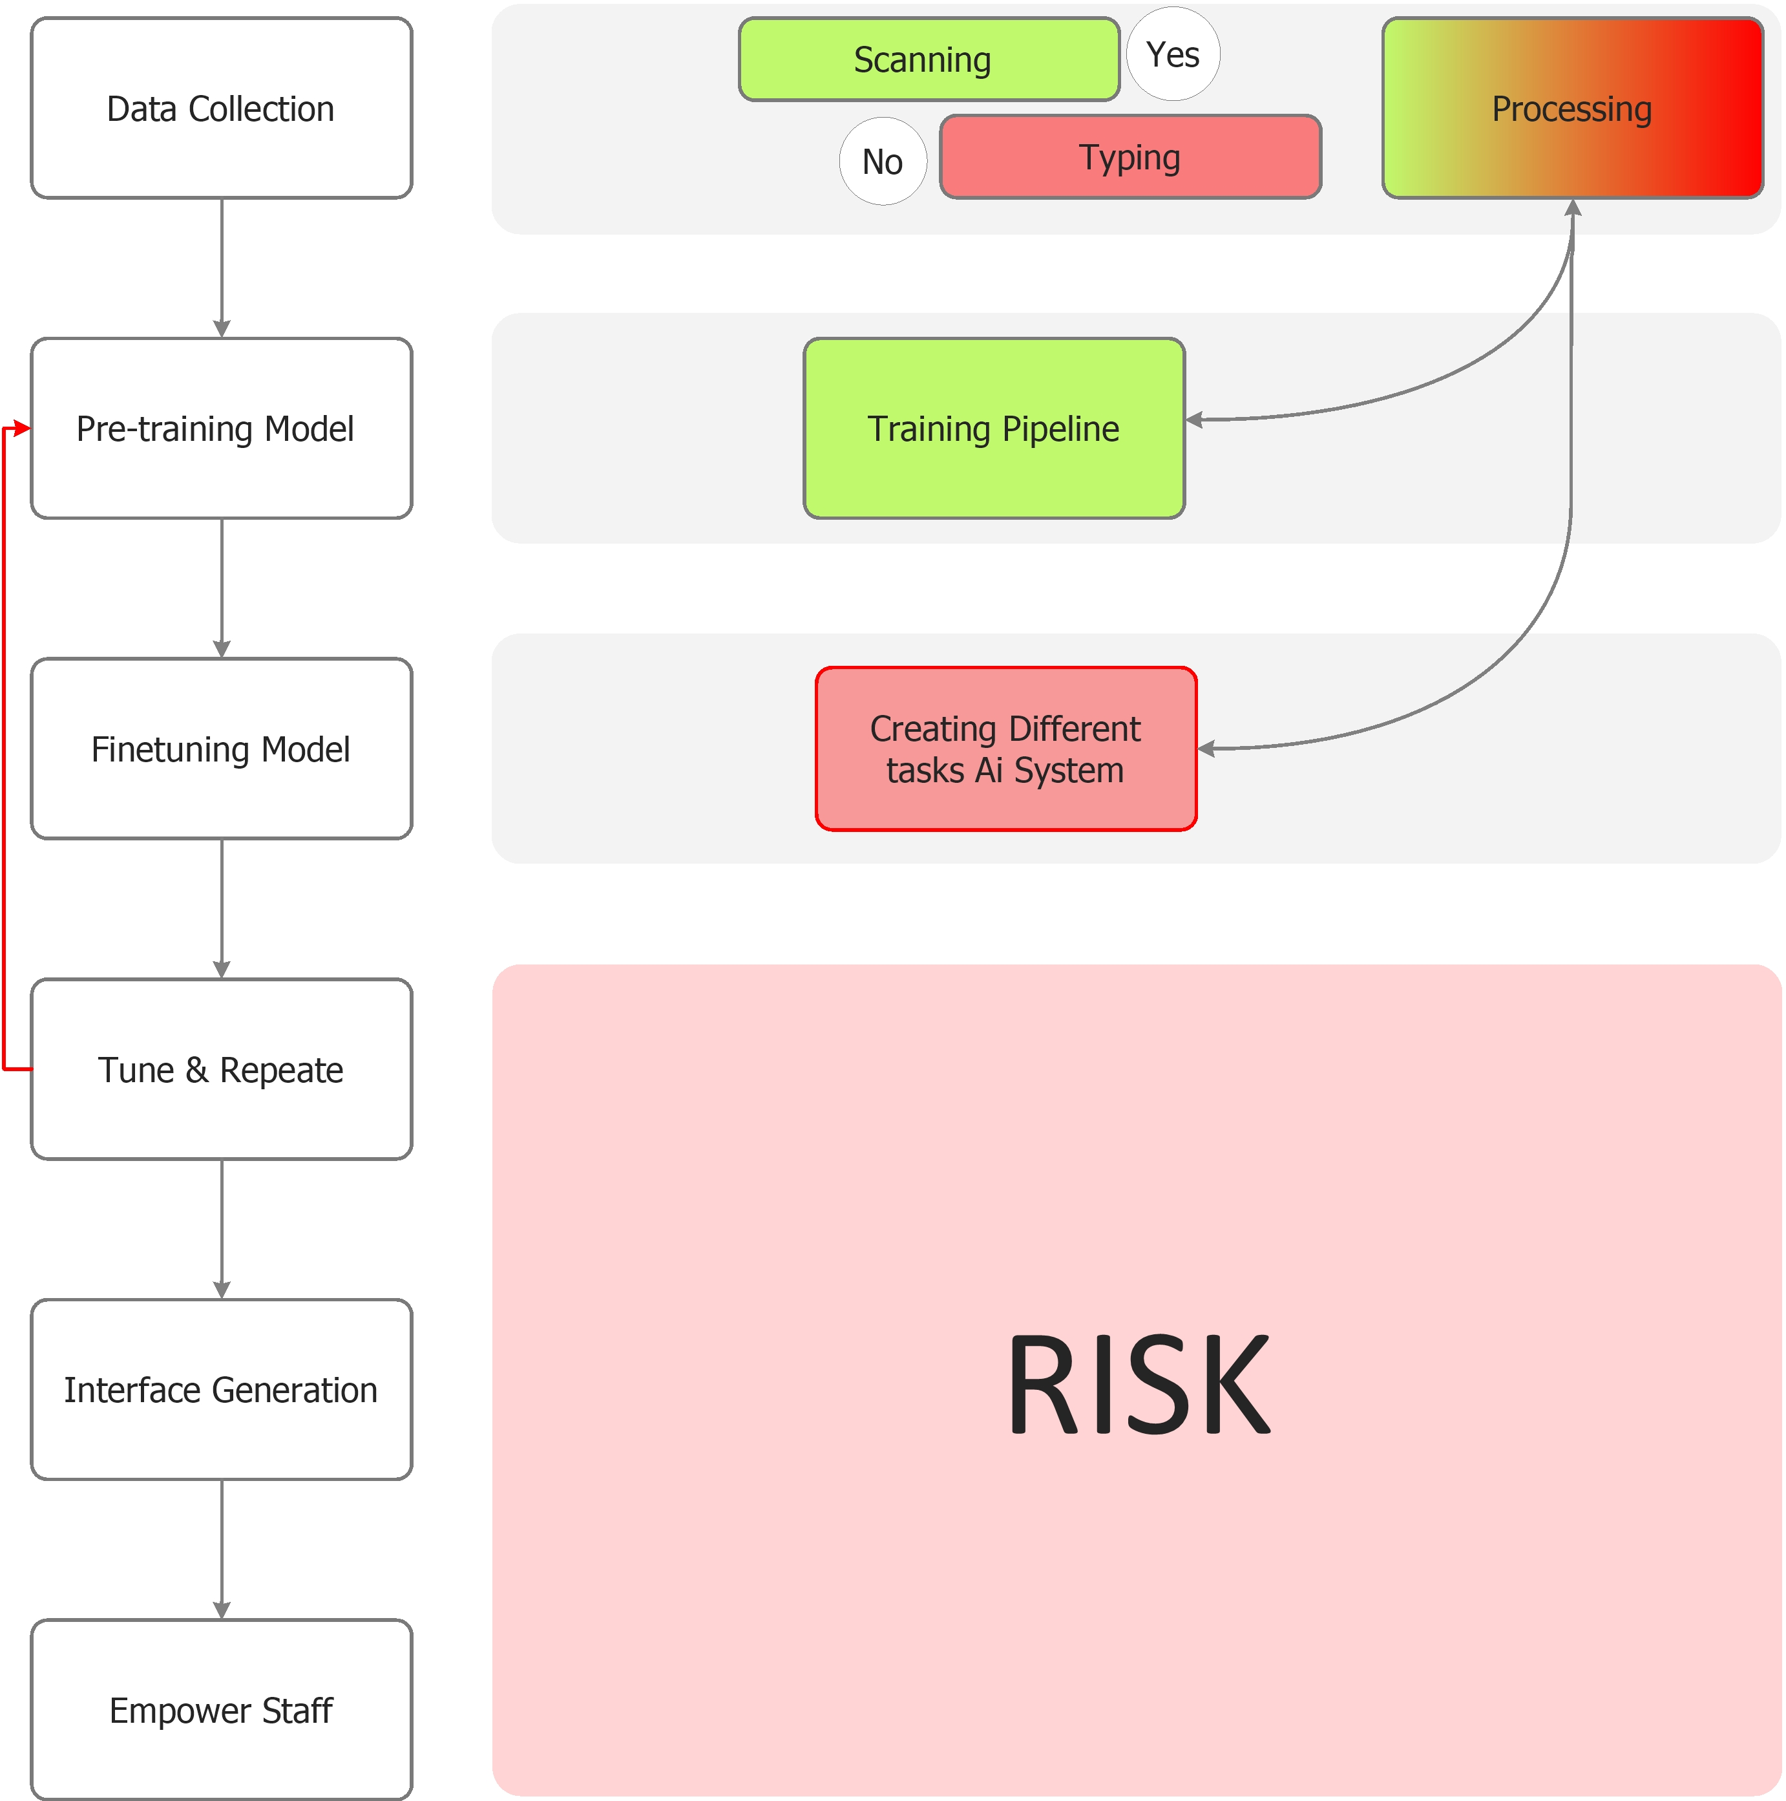
General Status

Slide 8
What is next

Slide 9
Dataset & Other
Dataset
Assistance PS to finish on time
Onboard new Staff to the project to work on the dataset (Finetune dataset)
Permission to share Dataset with UDSM since they have signed NDA
Other
GPU Machine
IT/ Data scientist to assist

